Slide 1
St Joseph’s Men’s Club general meeting presentation 5/5/20 via Zoom. History of the Diocese of Oakland by Dennis Dubro

Slide 2
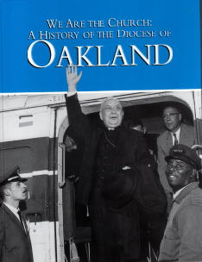
History of the Diocese of Oakland up to its 40th anniversary in 2002
On occasion of the 40th anniversary of the Oakland Diocese Jeffrey Burns and Mary Carmen Batiza published We Are the Church: A History of the Diocese of Oakland, Editiones du Signa, France, 2001
The photo is of the first bishop of Oakland, Floyd L. Begin, arriving by helicopter

Slide 3
Early joke – they named the freeway after him

Slide 4
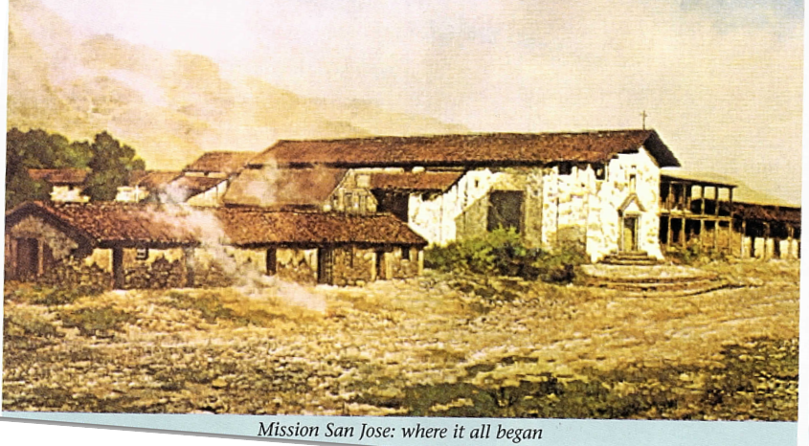
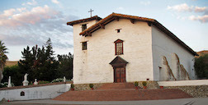
Mission San Jose: where it all began

Slide 5
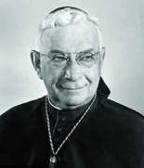
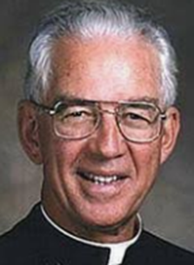
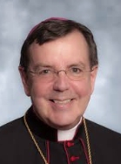
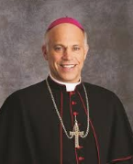
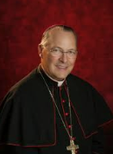
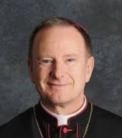
Bishops
Bishop Begin (1962-77)
East Bay native Bishop John S. Cummins (1977-2003)
Bishop Allen H. Vigneron (2003-09)
Bishop Salvatore J. Cordileone (2009-2012)
the Apostolic Administrator, Archbishop Alexander J. Brunett of Seattle (2012-13)
Bishop Michael C. Barber, SJ (2013-present)

Slide 6
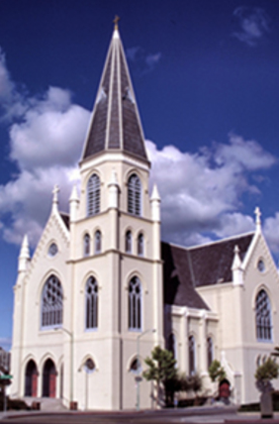
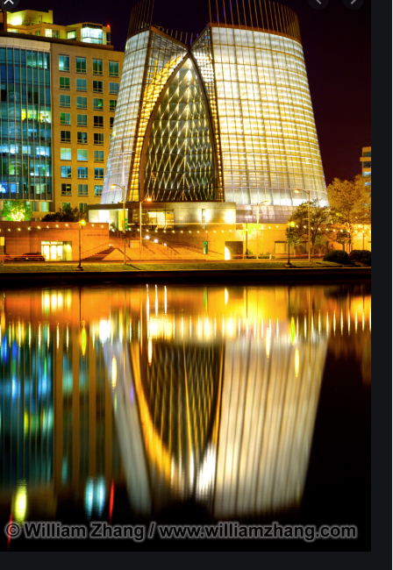
Cathedrals
St Francis de Sales (1962 to 1989)
Christ the Light (2008 to present)

Slide 7
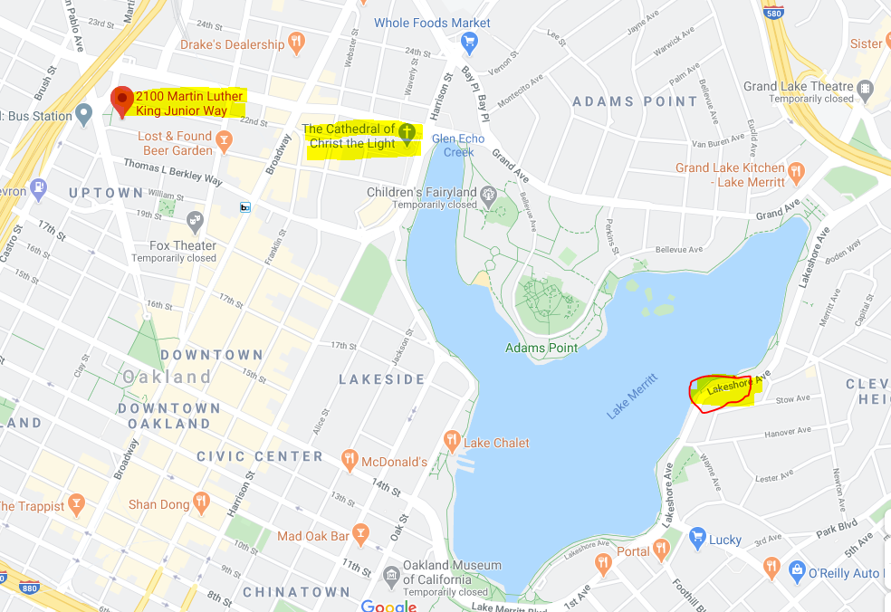
Oakland Locations

Slide 8
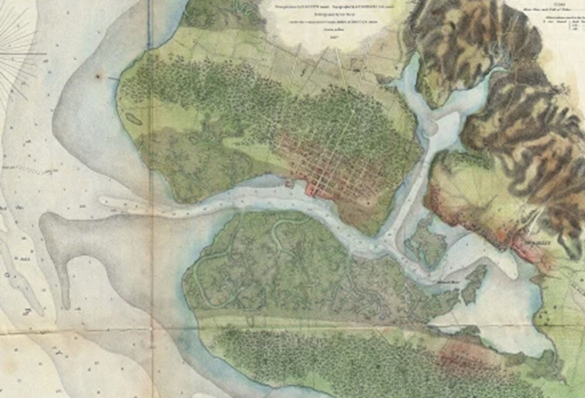
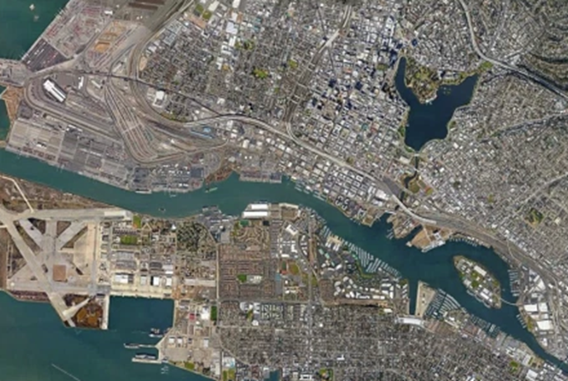
First Mass in Oakland
Notes:
In March 1776 Pedro Fages and Father Juan Crespi celebrated the first Masses in what would become the Diocese of Oakland in the swampy tidal pools of San Antonio Creek, which would later become Lake Merritt. That year, Mission San Francisco de Asis (#6) was established in San Francisco. In 1777, Mission Santa Clara (#8) was established. It was not until 1797 that Mission San Jose (#14) was established by Fr Lasuen, to be staffed by Fathers Isidoro Barcenilla and Augustin Merino.
A Catholic presence in what is now the Diocese of Oakland can be traced to March 27, 1772, when Franciscan Father Juan Crespi, traveling with a party of Spanish explorers, celebrated Mass near a swamp that would one day become Lake Merritt in Oakland. A quarter-century later, Franciscan Father Fermin Francisco de Lasuen founded Mission San Jose as the 14th of California’s eventual 21 missions. The friars of the mission sought to catechize and educate the Chochenyo, a division of the indigenous Ohlone people who lived throughout the region prior to the arrival of the Spaniards.
Mission San Jose would remain the only Catholic parish on the contra costa, the “opposite coast” from San Francisco, for the next 64 years.

Slide 9
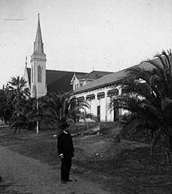
Pastors at St Joe’s
Fr O’Niel
Fr Williams
Fr William Abeloe
Fr Norkett
Fr Simas
Notes:
The chapel that had been constructed in 1809 continued to be used for Mass until it was destroyed in the earthquake of 1868. A new wooden church of Normal Gothic design was built and used until a new parish church was dedicated in 1965. Fr Williams initiated the project to rebuild the old mission church in 1973. It was completed in 1985.

Slide 10
Other St Joseph’s Parishes
St Joseph Old MSJ in Fremont
St Joseph Basilica Alameda
St Joseph the Worker in Oakland
St Joseph in Pinole

Slide 11
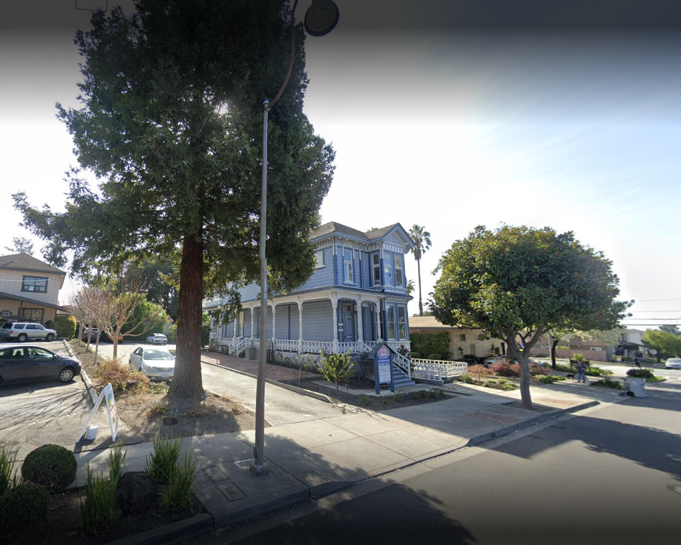
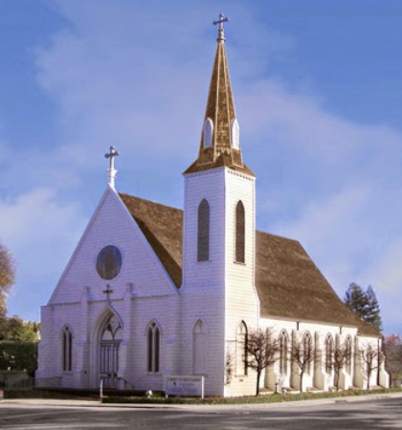
Moved
The Gothic-Normal church was sold to Saint Joseph Anglo-Catholic church and moved to 770 N El Camino Real, San Mateo
The rectory was sold to dentist Deon Bringhurst and moved to 152 Anza street.

Slide 12
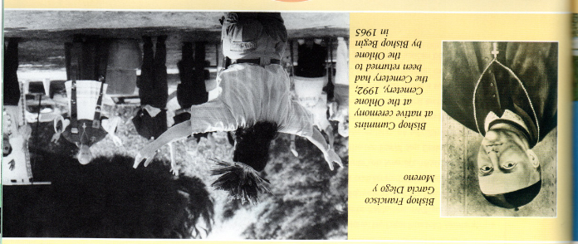
Just for entertainment, are there any familiar people in this picture?

Slide 13
Alta and Baja California
Notes:
The establishment of Mission San Jose was part of the Spanish imperial plan to settle Alta California – modern day California. Although the Spanish conquest of Mexico had begun in 1519, they had little interest in settling their northern territory until 1769 when Fr Serra and Captain Gaspar de Portola established the first Spanish mission in present day California at San Diego (#1).
In 1833, the Mexican government, which had declared itself independent of Spain in 1821, secularized the missions and in 1836, Mission San Jose was closed. This required a whole new Church structure and in 1840, the diocese of Ambas (both) Alta and Baja California was formed. Fr Moreno, a Spanish-Mexican was named the first bishop with his See being in Santa Barbara (#10). In 1846 war broke out between Mexico and the United States which ended in Mexico ceding Alta California to the United States in 1848. (as a point of reference, gold was discovered in 1849).

Slide 14
Alta California
Notes:
Since the Diocese was now split between two countries, the Vatican established the Diocese of Monterey (#2) for the United States in 1850 with Bishop Alemany as its head. In 1853, the Diocese of San Francisco (#6) was established with Monterey set as a suffrage diocese. Alemany was transferred to San Francisco.

Slide 15
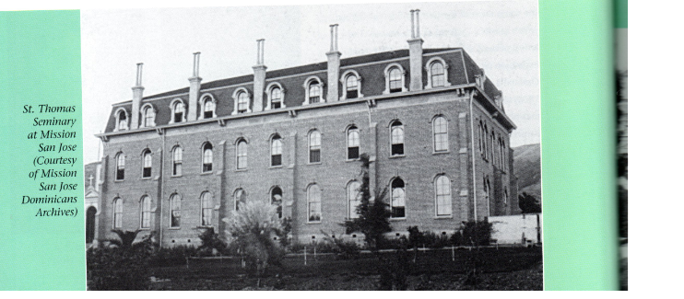
Need for clergy in Archdiocese of SF
Notes:
Need for clergy
Basic seminary operated out of Mission Dolores from 1853 to 1865
Next seminary operated out of a large 3 story building constructed on MSJ from 1883 to 1885.
Finally St Patricks’ was established in Menlo Park in 1898

Slide 16
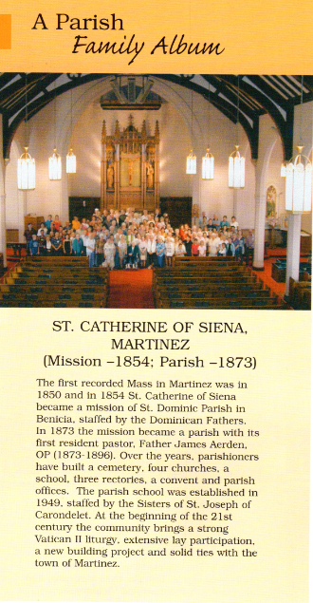
Dominicans
St Catherine’s in Martinez where our Fr Anthony is now.
Notes:
Bishop Alemany was accompanied to his see by Dominican Fr Francisco Vilarrasa and Sr Mary Goemaere who established their orders in the Diocese of Monterey. When San Francisco was established, the moved to Benecia from where the Frs founded St Catherine of Siena Parish in Martinez. Both orders served in various assignments in the Diocese. The Frs established their Priory and novitiate at St Albert’s in Oakland.

Slide 17
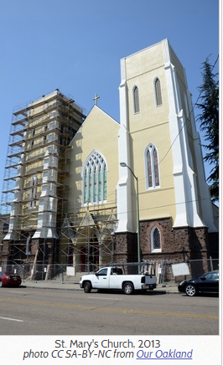
Sisters of the Holy Names
Notes:
The sisters were invited to Oakland from Canada in 1868 by Fr Michael King, pastor of St Mary’s of the Immaculate Conception, which was the only parish at the time in Oakland. The sisters, in addition to other apostolates, established Holy Names High School and Holy Names College, now University.

Slide 18
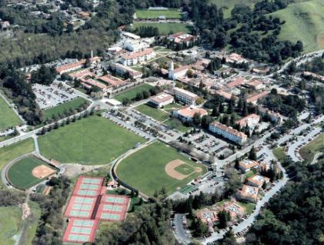
Christian Brothers
St Mary’s University, Moraga
Notes:
The brothers also came to San Francisco in 1868 at the invitation of Bishop Alemany, and they established themselves in Oakland in 1870 with a novitiate and a school. They served in numerous ministries and in 1927 established St Marys College, now University, in Moraga.

Slide 19
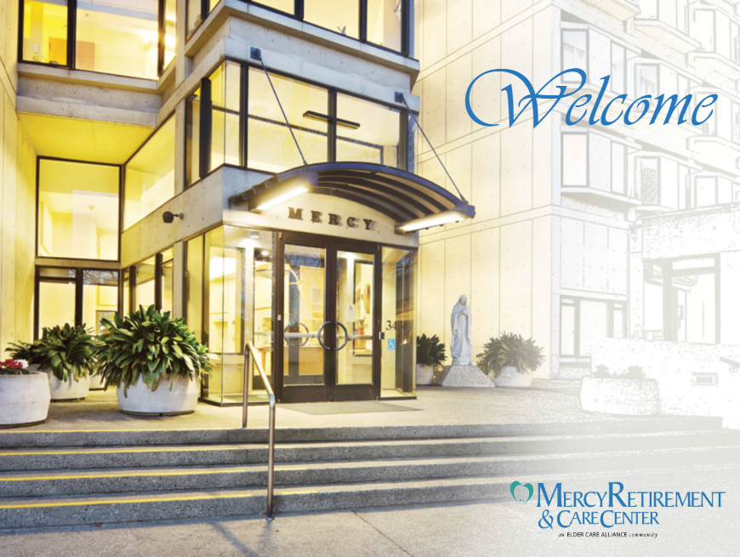
Sisters of Mercy
Mercy Retirement and Care Center
Notes:
The Sisters came to San Francisco from Ireland in 1854, and established Our Lady of Lourdes Academy in St Anthony’s parish in Oakland in 1877. They are known for their work with the elderly and established Serra Senior Center in 1961 in Oakland, which was renamed Mercy Retirement and Care Center in 1984.

Slide 20
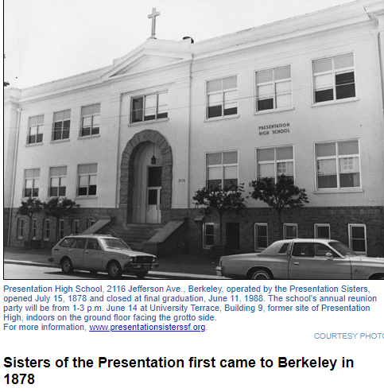
Sisters of the Presentation
Notes:
The Sisters also came from Ireland to San Francisco in 1854 and and established a convent in Oakland in 1877. They were served by priests from Sacred Heart parish and later St Joseph’s. Their Presentation High School was closed in 1988.

Slide 21
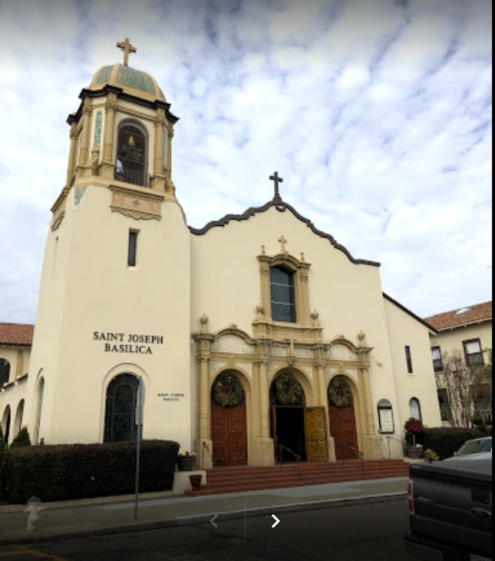
Sisters of Notre Dame de Namur
The sisters served in the Oakland Diocese at St Joseph’s Basilica in Alameda.
The are known for their college in the Archdiocese of San Francisco in Belmont.
Notes:
The Sister came to San Jose in 1851 and began serving at St Joseph’s in Alameda in 1873.

Slide 22
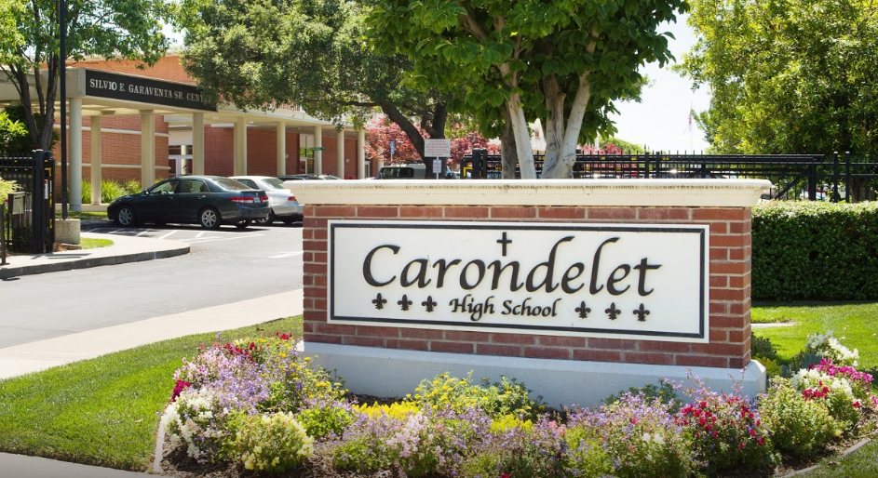
Sisters of St Joseph of Carondelet
Notes:
The Sisters were invited to Oakland in 1883 by Fr John McNally of St Patrick’s parish in West Oakland. They served in various ministries including establishing Carondelet High School in Concord in 1965.

Slide 23
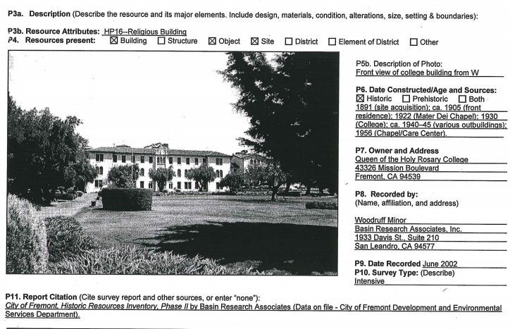
Mission San Jose Dominicans
Notes:
In 1876 Dominican sisters led by Mother Pia Backes arrived in San Francisco from Brooklyn, NY. She established the Congregation of the Queen of the Holy Rosary. They worked with German migrants. In 1891, they purchased Archbishop Riordan’s vacant seminary in Mission San Jose which they paid for by selling grapes and olives from the property. They established a school called the Josephinum, which due to poor enrollment was transformed into an orphanage and home for the disabled and moved down Washington Blvd to what is now a residential neighborhood off Adeline Common. The sisters have had an enduring presence at St Elizabeth’s school in Oakland.

Slide 24
St Mary of the Palms School For Girls

Slide 25
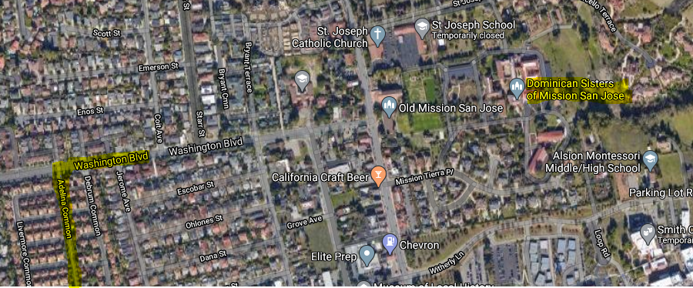
Placement Map

Slide 26
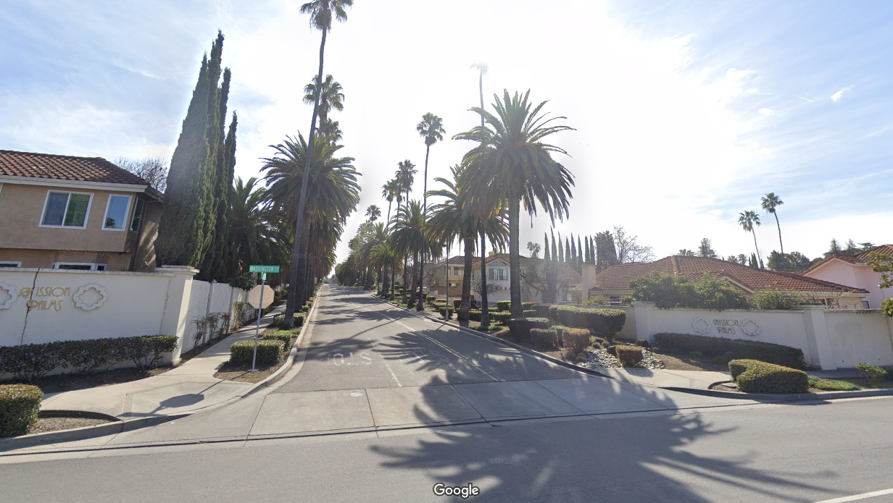
Current approach to the old school and orphanage

Slide 27
Classic Dominican Sisters

Slide 28
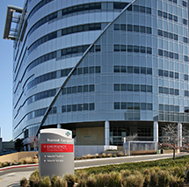
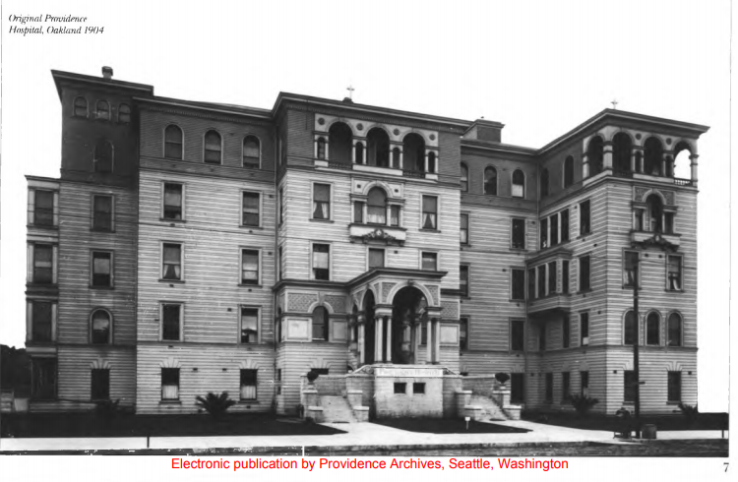
Sisters of Providence
Original hospital and modern Alta Bates Summit Hospital
Notes:
1901 to 1903 Archbishop Riordan invited the nursing Sisters of Providence to come from Montreal to establish a Catholic hospital. Over the years they opened two more hospitals which were merged with Merritt Hospital in 1991 to form Summit Hospital.

Slide 29
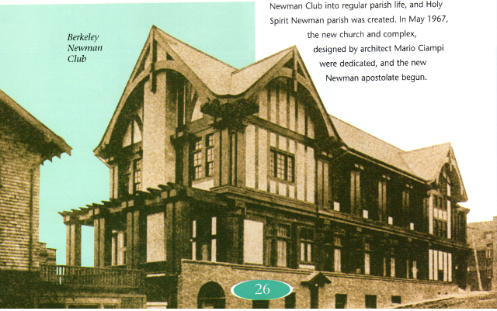
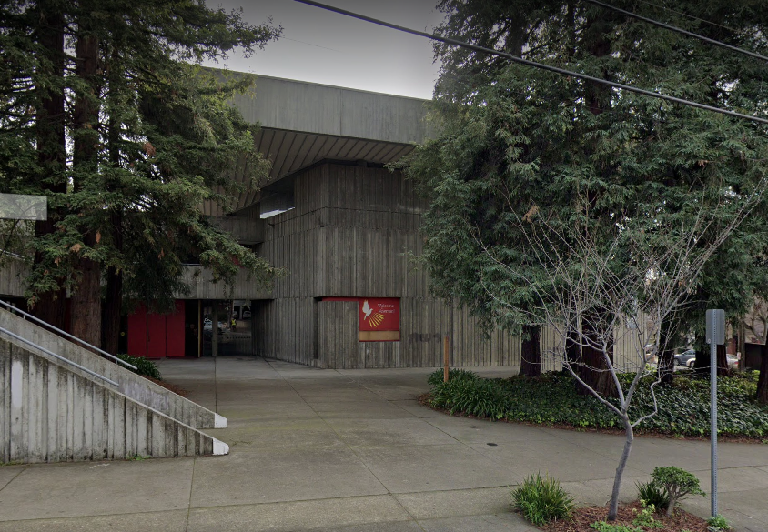
Paulists and Newman Club – UC Berkeley
Old Newman Club and new Holy Spirit Newman parish
Notes:
In 1899, a Newman Club was formed at the University of California at Berkeley under the tutelage of nearby St Joseph the Worker Parish. In 1906, Archbishop Riordan requested the Paulist Fathers to come and minister at the Newman Center. In 1965 Bishop Begin broke ground for a new Newman/Holy Spirit parish which was completed in 1967.

Slide 30
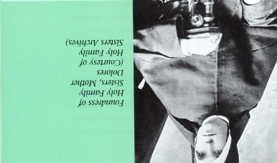
Sisters of the Holy Family
Notes:
The Sisters of the Holy Family are the only order of nuns established in the diocese which still exist. They were founded by Elizabeth Armer who took the name Mother Dolores. The sisters have had a long history in teaching children. In 1948 they purchased the Palmdale Estates in Mission San Jose and moved their motherhouse there in 1959 from San Francisco.

Slide 31
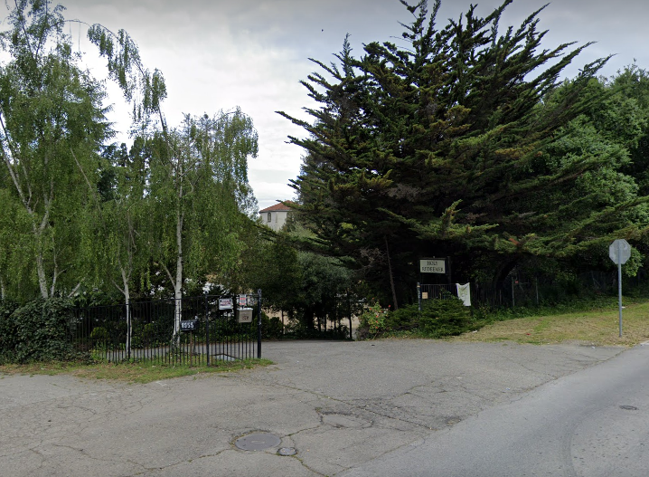
The Redemptorists
Notes:
In 1920 the Redemptorists came to Oakland and established Holy Redeemer College as a minor seminary. It was later closed and reopened as Holy Redeemer Center for a while, but is now permanently closed.

Slide 32
We are an immigrant church
We have catered to four major immigrant groups in our history
Irish
Portuguese – especially at Holy Spirit in Fremont
Germans
Italians

Slide 33
Societies
1885 Young Men’s Institute
1889 Young Ladies Institute
1895 League of the Cross Cadets, a temperance organization
1903 Knights of Columbus
1924 Italian Catholic Federation

Slide 34
Changes brought by WWII
Many African-Americans came to work in shipbuilding and other war industries.
The government started the Bracero Program to bring Mexican Nationals to the U.S. to work in the fields. Cesar Chavez and Dolores Huerta started the National Farmworkers Association which became the United Farmworkers.
The Diocese absorbed many priests who had fled Europe and the Nazi’s and the Communists.
The Diocese experiences great growth and expansion.

Slide 35
The Diocese of Oakland was born
The Diocese was born on January 13, 1962. It was spun off from the Archdiocese of San Francisco along with the dioceses of Santa Rosa and Stockton. San Jose came much later in 1981. Our bishop was Floyd L Begin. He initiated a “Spiritual Crusade” to kick off the Diocese on an energetic footing.
We soon embraced the years of Vatican II and the issues it brought, like Ecumenism and the new liturgy. St Francis de Sales parish in Oakland was dedicated as the Cathedral. It needed a renovation to meet the needs of a cathedral.

Slide 36
Turmoil: the thirst for social justice
We faced many new issues of social justice
The struggle for racial justice
United Farmworkers (UFW)
Bishop Cummins establish a Commission of Social Justice. The diocese paused to reflect on the findings and the Adult Education Program sponsored a number of meetings on “Civil Disorders and Our Community in 1968.
The Right To Life
In 1975 Bishop Begin issued a pastoral letter “On Criminal Justice and Corrections”. He established the Office of Criminal Justice within the Chancery which eventually was placed under Catholic Charities.
Turmoil was occurring within the Church over issues like the Vietnam War, civil rights and other social issues, Vatican II, Humanae Vitae, Catholics stopped going to Mass and priests and nuns were leaving.
Notes:
We faced many new issues of social justice
The struggle for racial justice
United Farmworkers (UFW)
Bishop Cummins establish a Commission of Social Justice. The diocese paused to reflect on the findings and the Adult Education Program sponsored a number of meetings on “Civil Disorders and Our Community in 1968.
The Right To Life
In 1975 Bishop Begin issued a pastoral letter “On Criminal Justice and Corrections”. He established the Office of Criminal Justice within the Chancery which eventually was placed under Catholic Charities.
Turmoil was occurring within the Church over issues like the Vietnam War, civil rights and other social issues, Vatican II, Humanae Vitae, Catholics stopped going to Mass and priests and nuns were leaving.

Slide 37
The beginning of the end (of the foundation)
SPRED – Special Religious Education for the developmentally disabled was founded in 1966
The charitable Saint Vincent de Paul Society was founded in France in 1833. It was established in Oakland at Sacred Heart Parish in 1878, but was dissolved in 1892. It was re-established during the Great Depression in 1931 at St Mary’s Parish in Oakland.
The San Antonio Youth Project was established at St Anthony’s Parish in 1962.
Catholic Schools were becoming a challenge as lay teachers started to outnumber religious with the resulting increase of costs due to wages.
On February 5, 1977, his 75th birthday, Bishop Begin submitted his resignation, as is required by Canon Law. He died shortly after on April 26, of cancer which he had battled with since 1972.
Notes:
SPRED – Special Religious Education for the developmentally disabled was founded in 1966
The charitable Saint Vincent de Paul Society was founded in France in 1833. It was established in Oakland at Sacred Heart Parish in 1878, but was dissolved in 1892. It was re-established during the Great Depression in 1931 at St Mary’s Parish in Oakland.
The San Antonio Youth Project was established at St Anthony’s Parish in 1962.
Catholic Schools were becoming a challenge as lay teachers started to outnumber religious with the resulting increase of costs due to wages.
On February 5, 1977, his 75th birthday, Bishop Begin submitted his resignation, as is required by Canon Law. He died shortly after on April 26, of cancer which he had battled with since 1972.

Slide 38
The era of John Cummins
Fr John Cummins was appointed the 2nd bishop of Oakland on May 3, 1977.
The world and the diocese were changing, especially the role of women (lay and religious) in ministry, as post-Vatican II, many women religious were re-evaluate their role in ministry and vocation.
Bishop Cummins appointed Sister Barbara Flannery of the Carondelet Sisters as Chancellor of the Diocese and Dominican Sr Rosemarie Hennessy as Superintendent of Schools.
Bishop Cummins was a strong advocate of social justice and called upon the institutions of higher learning to assist the Catholic Bishops in developing pastoral letters on peace and the economy.
The world was experiencing a lot of injustice in Central America which was a concern to many. By 1982, 30% of the parishes in the Diocese had social concerns committees.
Faith-based community organizing was established with the Oakland Community Organization (OCO). In later years, St Joseph’s MSJ joined a sister organization Congregations Organizing For Renewal (COR)
Parish pastoral councils were established as well as the Diocesan Pastoral Council.
Bishop Cummins established the RCIA: Rite of Christian Formation for Adults in 1981
Notes:
Fr John Cummins was appointed the 2nd bishop of Oakland on May 3, 1977.
The world and the diocese were changing, especially the role of women (lay and religious) in ministry, as post-Vatican II, many women religious were re-evaluating their role in ministry and vocation.
Bishop Cummins appointed Sister Barbara Flannery of the Carondelet Sisters as Chancellor of the Diocese and Dominican Sr Rosemarie Hennessy as Superintendent of Schools.
Bishop Cummins was a strong advocate of social justice and called upon the institutions of higher learning to assist the Catholic Bishops in developing pastoral letters on peace and the economy.
The world was experiencing a lot of injustice in Central America which was as concern to many. By 1982, 30% of the parishes in the Diocese had social concerns committees.
Faith-based community organizing was established with the Oakland Community Organization (OCO). In later years, St Joseph’s MSJ joined a sister organization Congregations Organizing For Renewal (COR)
Parish pastoral councils were established as well as the Diocesan Pastoral Council.
Bishop Cummins established the RCIA: Rite of Christian Formation for Adults in 1981

Slide 39
The era of John Cummins 2
On June 27, 1987, the Diocese celebrated its 25th Jubilee at Laney College and the Kaiser Convention Center
In 1987, the region was graced with the papal visit of Pope Saint John Paul II. Although he did not visit Oakland, many travelled to Monterey and San Francisco (Candlestick Park) to see him.
The Diocese suffered the Loma Prieta earthquake of 1989 which did permanent damage to the Cathedral of St Francis de Sales.
The Diocese also suffered from the firestorm in the Oakland Hills in 1991.
Bishop Cummins established a strategic planning process and implemented a pastoral plan
The School of Pastoral Ministry was established in 1995
After a trial run St Augustine’s in Pleasanton, the Diocese undertook the RENEW program in 1995.
New consultative bodies were established like the Presbyteral Council, a new Diocesan Pastoral Council and a Deacon’s Council.
As ordained clergy diminished, several non-ordained persons were established a parish administrators.
In 1978, the first class of permanent deacons was ordained.
The Diocese incardinated a number of Episcopal priest converts who were were ordained as Catholic priests, some of the married.
Notes:
On June 27, 1987, the Diocese celebrated its 25th Jubilee at Laney College and the Kaiser Convention Center
In 1987, the region was graced with the papal visit of Pope Saint John Paul II. Although he did not visit Oakland, many travelled to Monterey and San Francisco (Candlestick Park) to see him.
The Diocese suffered the Loma Prieta earthquake of 1989 which did permanent damage to the Cathedral of St Francis de Sales.
The Diocese also suffered from the firestorm in the Oakland Hills in 1991.
Bishop Cummins established a strategic planning process and implemented a pastoral plan
The School of Pastoral Ministry was established in 1995
After a trial run St Augustine’s in Pleasanton, the Diocese undertook the RENEW program in 1995.
New consultative bodies were established like the Presbyteral Council, a new Diocesan Pastoral Council and a Deacon’s Council.
As ordained clergy diminished, several non-ordained persons were established a parish administrators.
In 1978, the first class of permanent deacons was ordained.
The Diocese incardinated a number of Episcopal priest converts who were were ordained as Catholic priests, some of the married.

Slide 40
One Faith, Many Cultures
Latinos, African-Americans, Asians, Filipinos, Vietnamese, Chinese, Koreans, Kmhmu, Polish and other groups, including the Deaf.

Slide 41
JUBILEE 2000 AND BEYOND
The year 2000 was a Jubilee year established by Pope Saint John Paul II. It was a year filled with prayer and celebration.
Bishop Cummins issued a formal apology to all who had suffered abuse at the hands of the Church
Diocese sponsored the traveling Pilgrim Image of Our Lady of Guadalupe.
On November 11, 2000 the Diocese celebrated the Jubilee year with a Eucharistic Liturgy at the Oakland Coliseum Arena.
Bishop Cummins commissioned a study to explore the possibility of building a new cathedral, which was to be called “The Cathedral of Christ the Light”. [Ground was broken on May 21, 2005, and Christ the Light was consecrated and dedicated by Bishop Allen Henry Vigneron on September 25, 2008]

Slide 42
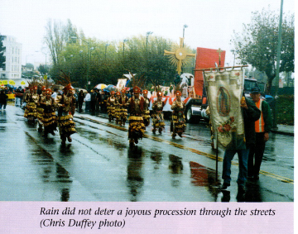
Pilgrim Virgin

Slide 43
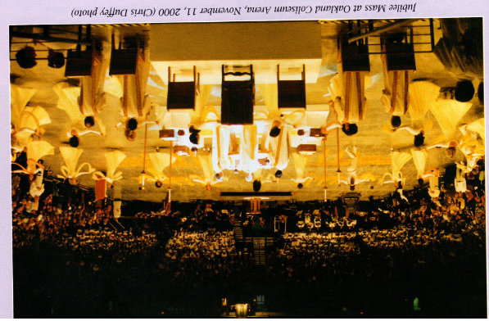
2000 Jubilee Mass at Oakland Coleseum

Slide 44
Questions, comments, or other interesting interludes

