Slide 2
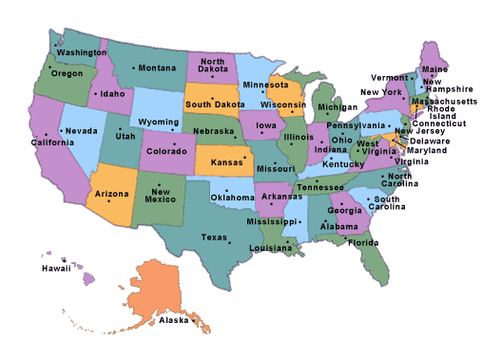
50 State Quiz

Slide 3
#1 Which state did Vermont come from?

Slide 4
Answer 1: The Vermont Republic fought claims from New York

Slide 5
#2 Which state did Kentucky come from?

Slide 6
Answer 2 -- Kentucky was split off from Virginia

Slide 7
#3 Which state did West Virginia come from?

Slide 8
Answer 3 – After Kentucky, West Virginia was split off from Virginia

Slide 9
#4. Which state contains the geographic center of the 48 contiguous states?

Slide 10
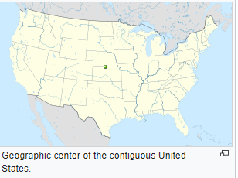
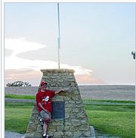
Answer 4 – The geographic center as located in a 1918 survey is located at 39°50′N 98°35′W, about 2.6 miles (4.2 km) northwest of the center of Lebanon, Kansas, approximately 12 miles (19 km) south of the Kansas–Nebraska border.

Slide 11
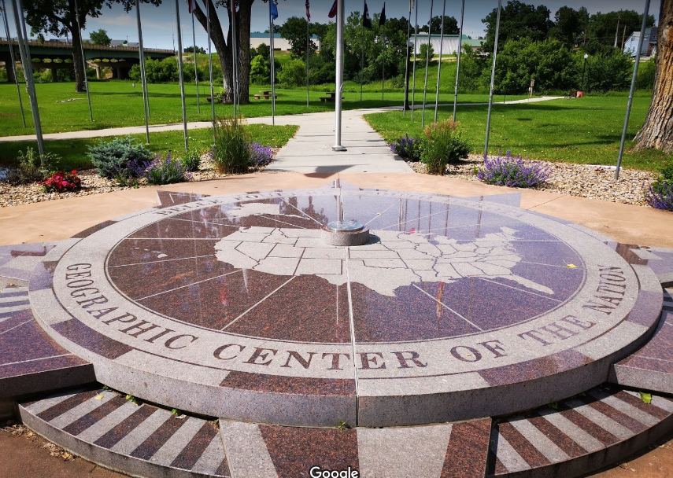
It is distinct from the geographic center of the United States, which reflects the 1959 additions of the states of Alaska and Hawaii, which is located at a point northeast of Belle Fourche, South Dakota

Slide 12
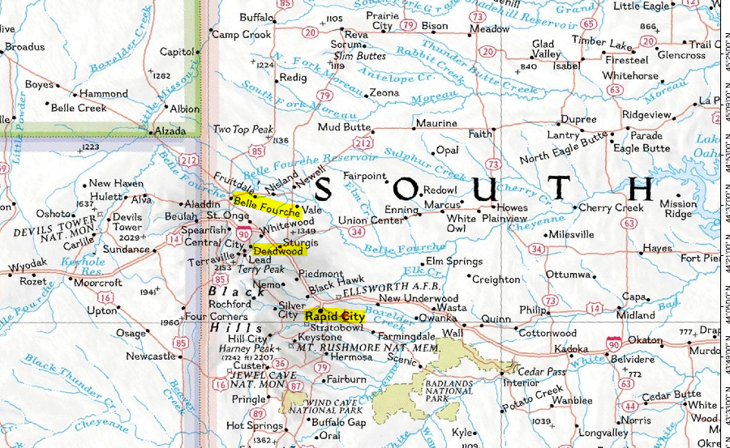
You can see Belle Fourche highlighted along with Deadwood (where “Wild Bill” Hickock was murdered) and Rapid City, SD.

Slide 13
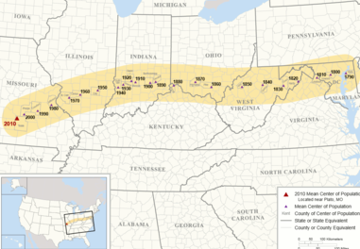
It is also different from the population center which has been drifting West over time.

Slide 14
#5 Mount Rushmore is located in South Dakota. Where is the Crazy Horse Monument?

Slide 15
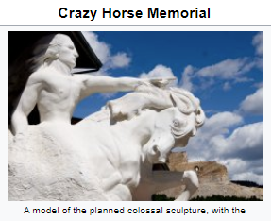
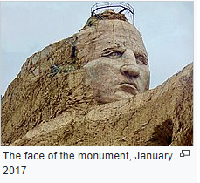
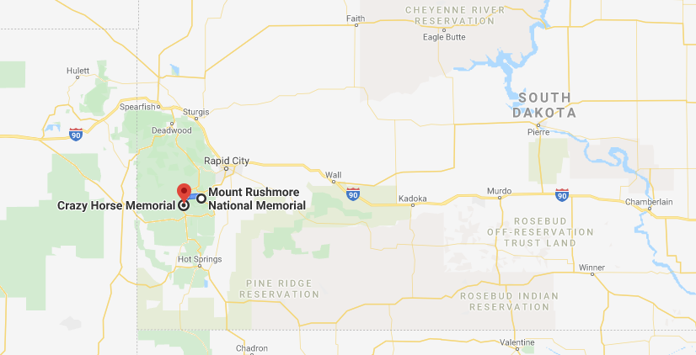
Answer 5 -- South Dakota , not far from Mt Rushmore

Slide 16
#6 Which state has the site of the Little Bighorn Battlefield where Custer had his Last Stand against Sitting Bull.

Slide 17
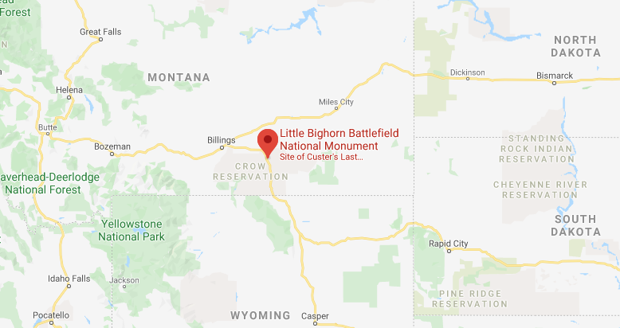
Answer 6 --- Montana

Slide 18
#7. Name a state which has part of Yellowstone National Park which is the first national park.

Slide 19
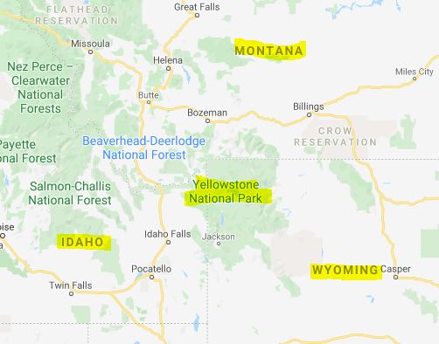
Answer 7 --- Wyoming, Montana and Idaho.

Slide 20
#8. Which state has Stone Mountain which commemorates 3 confederate leaders. Jefferson Davis, Robert E. Lee and Stonewall Jackson, on Stone Mountain Park ?

Slide 21
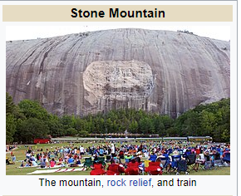
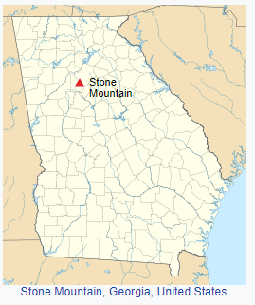
Answer 8 --- Georgia

Slide 22
#9. Name a state which meets at the Four Corners, the only place where four states meet in one point.

Slide 23
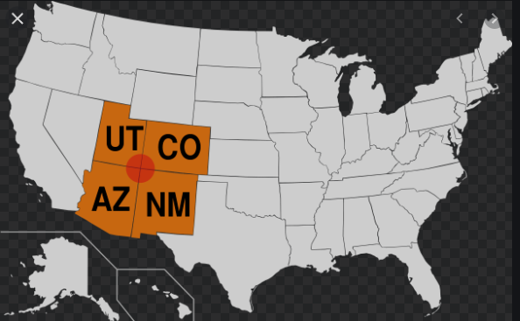
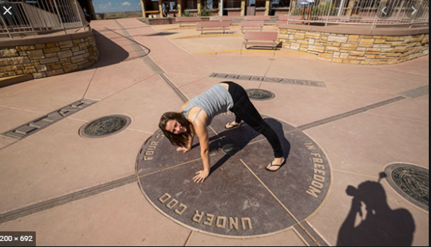
Answer 9 --- -- states of Arizona, Colorado, New Mexico, and Utah. It is the only point in the United States shared by four states, leading to the area being named the Four Corners region.

Slide 24
#10. Which state has the most telescopes in the world

Slide 25
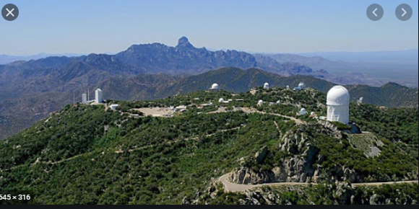
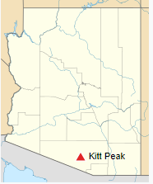
Answer 10 --- Arizona Kitt Peak, 56 miles southwest of Tuscon, operates three major nighttime telescopes and hosts the facilities of consortia which operate 22 optical telescopes and two radio telescopes.

Slide 26
#11. Which state has the only active diamond mine

Slide 27
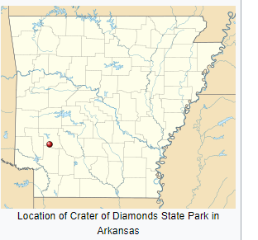
Answer 11 --- Arkansas

Slide 28
#12. What is the only state that has a royal palace

Slide 29
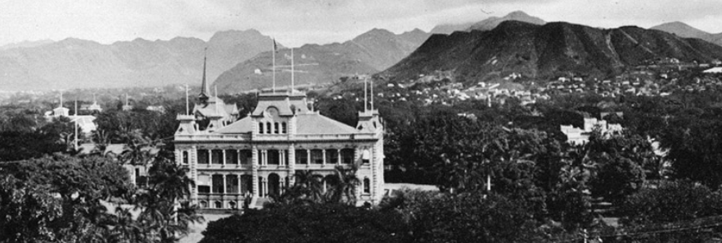
Answer 12 --- Hawaii -- The only royal palace in the U.S. (Iolani)

Slide 30
#13. Which state has Graceland, the estate and gravesite of Elvis Presley ?

Slide 31
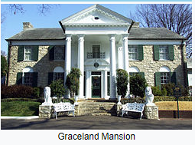
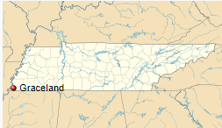
Answer 13 --- Tennessee

Slide 32
#14. In which state was the first-ever nuclear submarine was built?

Slide 33
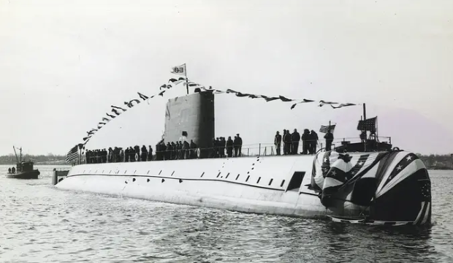
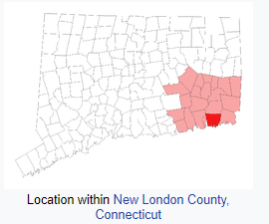
Answer 14 --- Connecticut . On January 21, 1954, at 10:57am, the USS Nautilus, the world’s first nuclear submarine, slid off a dry dock at General Dynamics in Groton, Connecticut and splashed into the waters of the Thames River, officially launching the United States Navy into the nuclear era.

Slide 34
#15. Which state has the longest cave in the world?

Slide 35
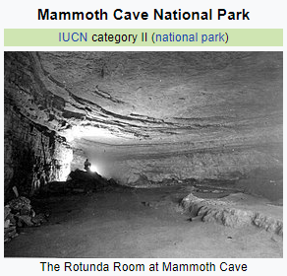
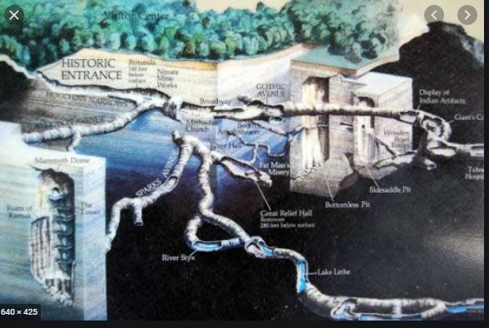
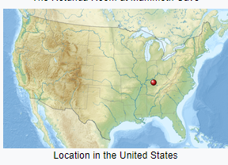
Answer 15 --- Kentucky Mammoth Cave is 360 miles long, the longest cave in the world.

Slide 36
#16. Which state has the city with the largest number of hotel rooms of any city in the world ?

Slide 37
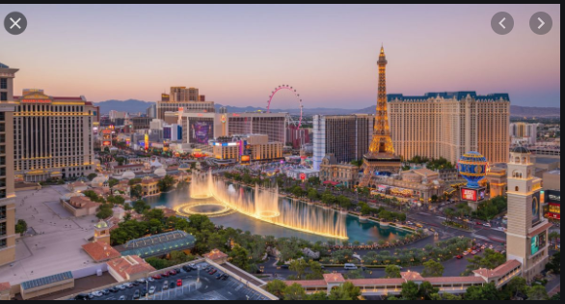
Answer 16 --- Nevada Las Vegas has the largest number of hotel rooms of any city in the world, with over 62,000 on the Vegas Strip alone.

Slide 38
#17. Which state shares a National Park with another country?

Slide 39
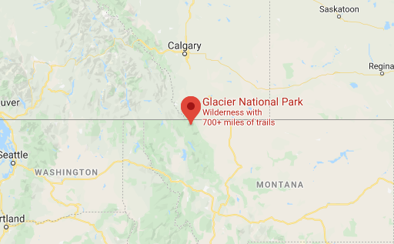
Answer 17 --- Montana shares Glacier National Park with Canada

Slide 40
#18. Which state is home to the world's largest basket at over seven stories tall?

Slide 41
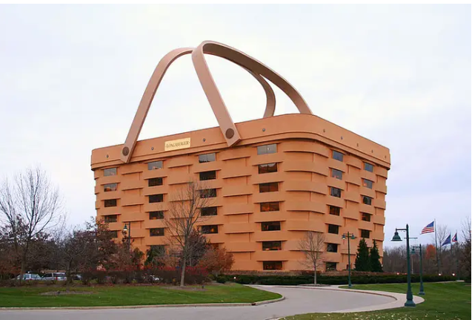
Answer 18 --- Ohio Dresden

Slide 42
#19. Which state is the home of the largest office building in the world containing over 68,000 miles of phone lines?

Slide 43
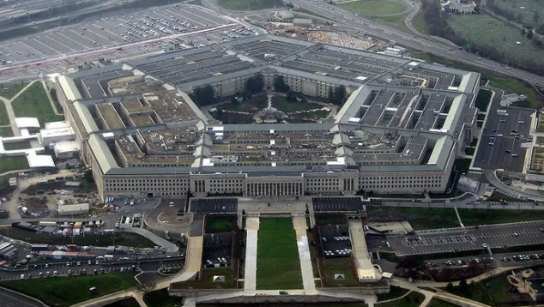
Answer 19 --- Virginia is home to the Pentagon

Slide 44
#20. Which state is home to the world's largest building by volume

Slide 45
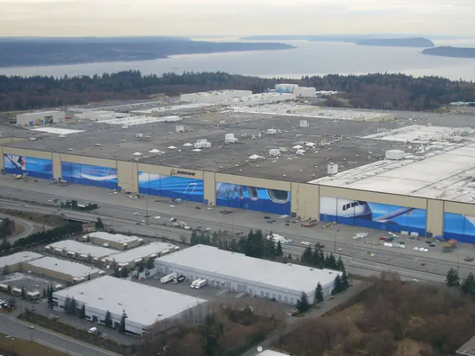
Answer 20 --- Washington, Boeing's plant in Everett is over 472 million cubic feet.

Slide 46
#21. Which state is home to the world's largest office chair ?

Slide 47
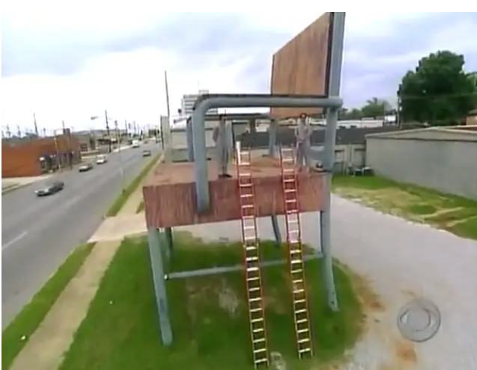
Answer 21 --- Alabama -- in Anniston

Slide 48
#22. Which state is named for/from the Spanish “ruddy” or “red”?

Slide 49
Answer 22 --- Colorado, for its reddish soil

Slide 50
#23. Which state is named from an Indian word meaning “Father of Waters”?

Slide 51
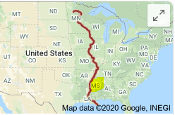
Answer 23 --- Mississippi

Slide 52
#24. Which state is named from the Spanish word meaning “mountain.”

Slide 53
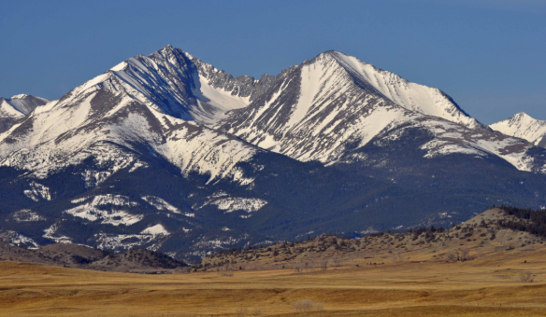
Answer 24 --- Montana

Slide 54
#25. Which state is named for its snow-capped peaks in Spanish ?

Slide 55
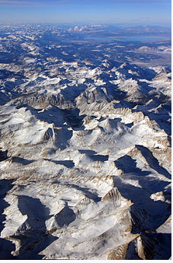
Answer 25 --- Nevada

Slide 56
#26. Which state is named from the French for its green mountains ?

Slide 57
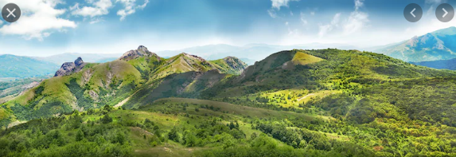
Answer 26 --- Vermont “vert mont,”

Slide 58
#27. Name a state named after royalty

Slide 59
Answer 27 --- States names after royalty
Virginia/West Virginia -- Elizabeth “Virgin Queen” of England
North/South Carolina -- Charles I of England
Maryland --Henrietta Maria (queen of Charles I of England)
Louisiana -- Louis XIV of France
Georgia -- George II of England
New York – Duke of York

Slide 60
#28. Which state was named for its Indians ?

Slide 61
Answer 28 Indiana -- Meaning “land of Indians”

Slide 62
#29. Which state is called “the Beaver State”?

Slide 63
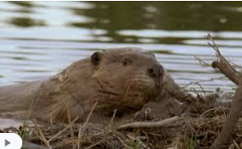
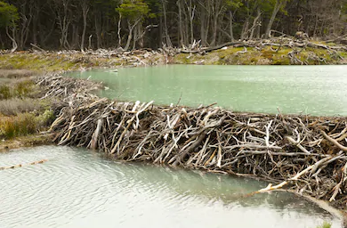
Answer 29 ” --- Oregon

Slide 64
#30. Which state is the Palmetto (a type of palm) State ?

Slide 65
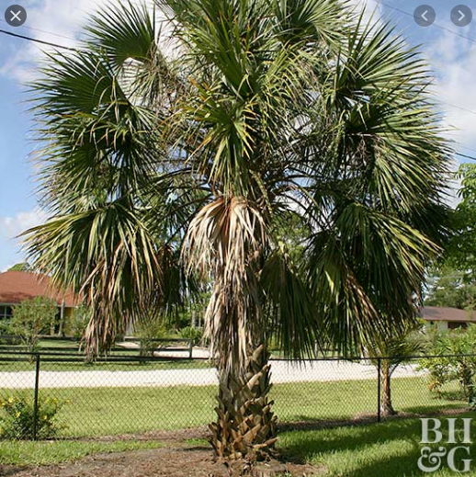
Answer 30 --- South Carolina

Slide 66
#31. Which state is the Buckeye State?

Slide 67
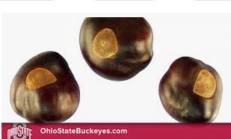
Answer 31 --- Ohio

Slide 68
#32. Which state is the Hawkeye State ?

Slide 69
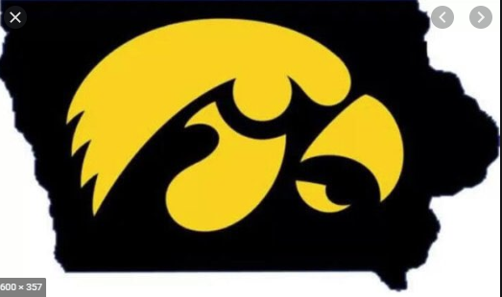
Answer 32 Ohio

Slide 70
#33. Which state is the Granite State?

Slide 71
Answer 33 --- New Hampshire

Slide 72
#34. Which state has a town which shares a border and several of its buildings -- a library and an opera house -- with Canada ?

Slide 73
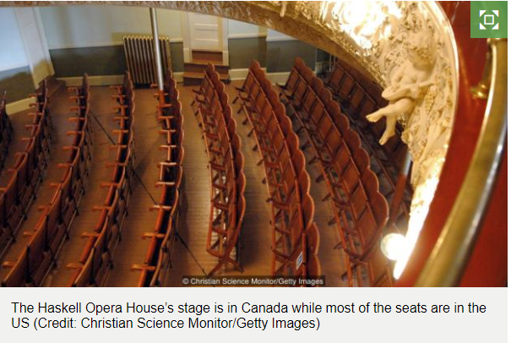
Answer 34 --- Vermont The town of Derby Line shares a border with Stanstead, Quebec, Canada

Slide 74
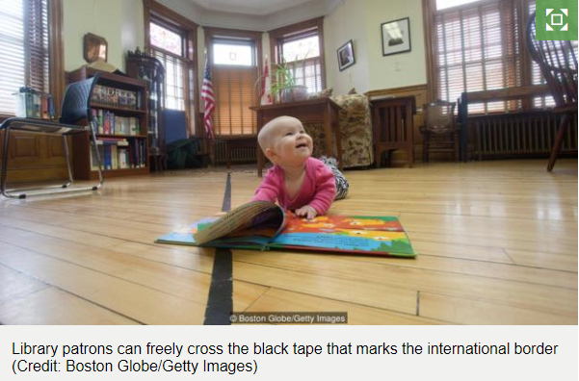

Slide 75
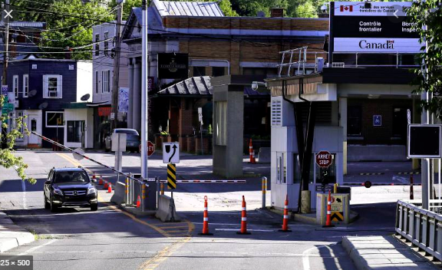
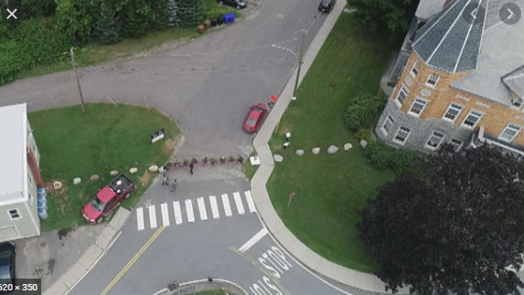

Slide 76
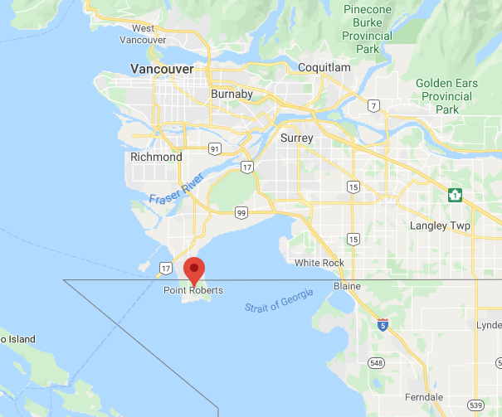
Interesting extension of this question is the “enclave” of Point Roberts, part of Washington, which can only be approached by land from Canada. It came from declaring the 49th parallel as the border between the U.S. and Canda in the 1848 treaty. It is rumored that the U.S. Marshalls Service maintains people from the Witness Protection program there.

Slide 77
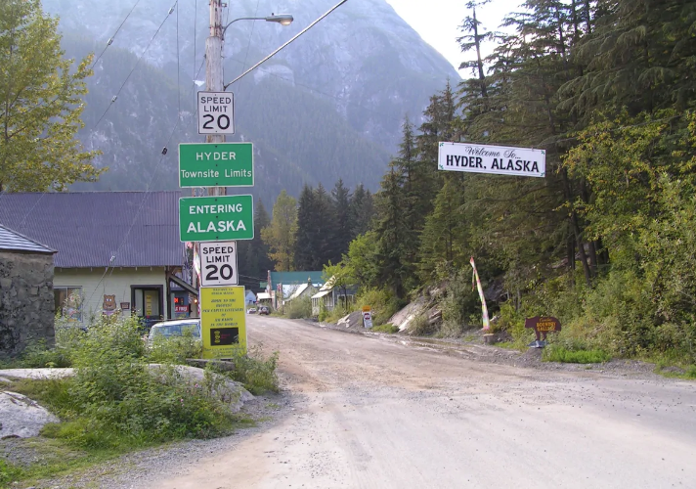
There is another interesting border crossing between Stewart, B.C., Canada and Hyder, Alaska

Slide 78
#35. Name a “rectangular” state .

Slide 79
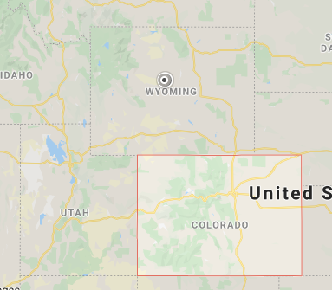
Answer 35 --- Wyoming, Colorado .

Slide 80
#36. Name a state with “straight-line” boundaries

Slide 81
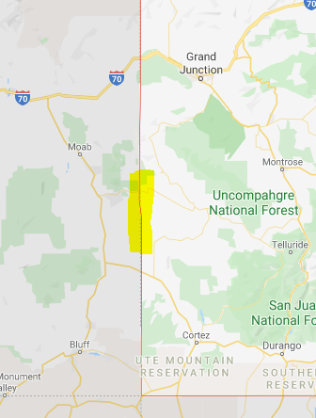
Answer 36 --- Wyoming, Colorado . Unfortunately, Utah does not qualify due to a surveying error where two approachs, one from the North and one from the South did not match up.

Slide 82
#37. Which state has no straight-line boundaries

Slide 83
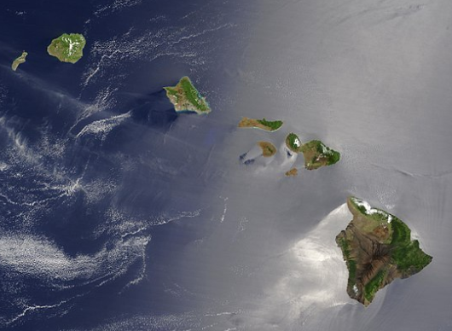
Answer 37 --- Hawaii

Slide 84
#38. Which state was a major component of and came from Deseret?

Slide 85
Answer 38 --- Utah The State of Deseret was a provisional state of the United States, proposed in 1849 by settlers from The Church of Jesus Christ of Latter-day Saints in Salt Lake City. The provisional state existed for slightly over two years and was never recognized by the United States government.

Slide 86
#39. Which is the smallest state?

Slide 87
Answer 39 --- Rhode Island at 1,214 sq miles. Hawaii is 10,931 sq miles

Slide 88
#40. Which state has only one border with another state ?

Slide 89
Answer 40 --- Maine It shares a border with New Hampshire.

Slide 90
#41. Which states donated land for Washington, D.C. (ten miles square)?

Slide 91
Answer 41 --- Maryland and Virginia

Slide 92
#42. Which state had the land donated back?

Slide 93
Answer 42 -- Virginia

Slide 94
#43. Which state has two homes for its governor?

Slide 95
Answser 43 --- Michigan is the only state to maintain two residences for the governor's use; in addition to the governor's mansion in Lansing, the governor has the use of a summer home on Mackinac Island.

Slide 96
#44. Which is the 1st state?

Slide 97
Answer 44 --- In Dover, Delaware, the U.S. Constitution was unanimously ratified by all 30 delegates to the Delaware Constitutional Convention, making Delaware the first state of the modern United States.

Slide 98
#45. Which state is Kansas City in ?

Slide 99
Answer 45 --- There is one in Kansas and one in Missouri.

Slide 100
#46. Which state passed a law to definite how the state name is pronounced?

Slide 101
Answer 46 --- Arkansas The name originated from Algonquian Indian names for the area, which was picked up by the French influence in the region. In French, the “s” is not pronounced in the plural. The United States opted to keep the French spelling and pronunciation after the acquisition of the Louisiana territory in 1803. But it wasn’t until 1881 that the Arkansas state legislature made the pronunciation official after the debate came to a fore between two senators So it is pronounced “Ar’-Kan-Saw” not “Ar-Kan’-zis”.

Slide 102
#47. Which state has the first, or lowest Zip Code?

Slide 103
Answer 47 --- New York The lowest in-use zip code is 00501 and it belongs to the IRS mail processing center located in Holtsville, New York.

Slide 104
#48. Which state has the highest Zip Code?

Slide 105
Answer 48 --- Alaska The highest in-use zip code, 99950, belongs to the city of Ketchikan, Alaska

Slide 106
#49. Name a state which holds a Smithsonian Museum that is not in Washington, D.C.

Slide 107
Answer 49 --- a. New York, Bowling Green, National Museum of the American Indian's George Gustav Heye Center b. New York, 5th Avenue, Cooper Hewitt, Smithsonian Design Museum c. Virginia, Chantilly, National Air and Space Museum's Steven F. Udvar-Hazy Center

Slide 108
#50. Which state has NIST – the National Institute of Standards and Technology – which used to be called NBS, the National Bureau of Standards or Bureau of Weights and Measures, which legally defines measurement standards for commerce like the gallon and the pound?

Slide 109
Answer 50 --- there are two possible answers The main divisions of NIST are in Maryland, at Gaithersburg and the Time and Frequency Division is in Colorado at Boulder

